Slide 1
Daily Review Topics Unit 1
Courtesy of @APBioPenguins

Slide 2
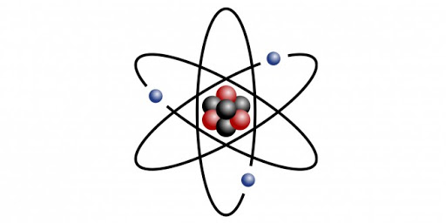
Atoms, Electrons, Isotopes
Where are electrons found?
A.) In the nucleus B.) In the energy orbitals surrounding the nucleus

Slide 3
Atoms, Electrons, Isotopes
Where are electrons found?
A.) In the nucleus B.) In the energy orbitals surrounding the nucleus

Slide 4
Atoms, Electrons, Isotopes continued
What is an isotope?

Slide 5
Atoms, Electrons, Isotopes continued
What is an isotope?
Isotopes have the same number of protons (so they’re the same element), but a different number of neutrons (changing the atomic mass).
Example:
Carbon 12/14

Slide 6
Atoms, Electrons, Isotopes
What are valence electrons important for bonding?

Slide 7
Atoms, Electrons, Isotopes
What are valence electrons important for bonding?
They tell the number of covalent bonds that can be formed and helps to identify whether a bond will be covalent or ionic.

Slide 8
Bonds
What makes a bond covalent?

Slide 9
Bonds
What makes a bond covalent?
If the valence electrons are shared.

Slide 10
Bonds
What type of bond involves equal sharing of electrons?
Polar Covalent
Nonpolar Covalent

Slide 11
Bonds
What type of bond involves equal sharing of electrons?
Polar Covalent
Nonpolar Covalent

Slide 12
Bonds
What effect does a nonpolar bond have on dissolving in water?

Slide 13
Bonds
What effect does a nonpolar bond have on dissolving in water?
If a bond is nonpolar, it will inhibit dissolving in water. This explains why the fatty acid chains of the phospholipid bilayer are arranged facing one another instead of the extracellular or intracellular space.

Slide 14
Bonds
How does the polar covalent bond affect dissolving in water?

Slide 15
Bonds
How does the polar covalent bond affect dissolving in water?
The polar covalent bond allows materials to dissolve in the polar substance (water). We call this hydrophilic. This explains why the phosphate heads (charged) of the phospholipid bilayer will arrange themselves facing the extracellular and intracellular space.

Slide 16
Bonds
What type of bond is the oxygen/hydrogen bond?
A. Polar Covalent
B. Nonpolar Covalent

Slide 17
Bonds
What type of bond is the oxygen/hydrogen bond?
A. Polar Covalent
B. Nonpolar Covalent

Slide 18
Bonds
What is an ionic bond?

Slide 19
Bonds
What is an ionic bond?
An ionic bond forms when one atom is more electronegative and removes an electron(s) from another atom. This creates ions which are attracted to one another. The ionic bond is the attractive force between the cation (+) and the anion (-).

Slide 20
Bonds
Which of the following is a hydrogen bond?
O-H
C-H
H and N-H
H and C-C

Slide 21
Bonds
Which of the following is a hydrogen bond?
O-H
C-H
H and N-H
H and C-C

Slide 22
Bonds
Where are H bonds in DNA?
Between sugar and phosphate
Between oxygen and hydrogen in sugar
Between nitrogenous base and sugar
Between nitrogenous bases of two strands

Slide 23
Bonds
Where are H bonds in DNA?
Between sugar and phosphate
Between oxygen and hydrogen in sugar
Between nitrogenous base and sugar
Between nitrogenous bases of two strands

Slide 24
Bonds
What level of protein structure are in H bonds?
Primary
Secondary
Tertiary

Slide 25
Bonds
What level of protein structure are in H bonds?
Primary
Secondary
Tertiary

Slide 26
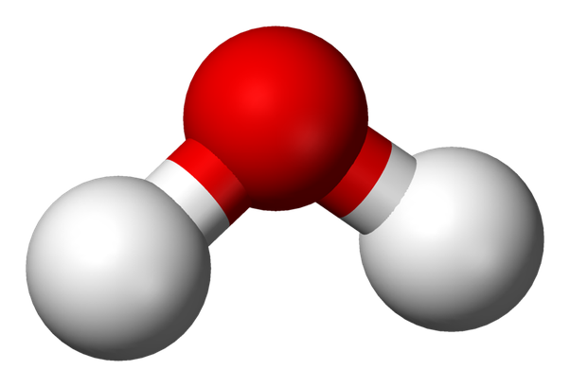
Water/pH and Buffers
The bond in a water molecule is…
Nonpolar Covalent
Polar Covalent
Ionic
Hydrogen

Slide 27
Water/pH and Buffers
The bond in a water molecule is…
Nonpolar Covalent
Polar Covalent
Ionic
Hydrogen

Slide 28
Water/pH and Buffers
The bond between water molecules is…
Nonpolar Covalent
Polar Covalent
Ionic
Hydrogen

Slide 29
Water/pH and Buffers
The bond between water molecules is…
Nonpolar Covalent
Polar Covalent
Ionic
Hydrogen

Slide 30
Water/pH and Buffers
How does water move up the vascular tissue in plants?

Slide 31
Water/pH and Buffers
How does water move up the vascular tissue in plants?
Due to cohesion and adhesion.
Cohesion- water attracted to other water molecules
Adhesion - water attracted to other polar substances (think capillary action).

Slide 32
Water/pH and Buffers
Why is the temperature of coastal regions relatively consistent?

Slide 33
Water/pH and Buffers
Why is the temperature of coastal regions relatively consistent?
It has high specific heat, meaning it can absorb a large amount of heat without a large temperature change. In these regions the water absorbs heat during the day and releases it at night keeping temperatures regulated.

Slide 34
Water/pH and Buffers
Which property allows you to keep cool in the summer?
Less dense when frozen
Water is polar
Cohesion/Adhesion
Evaporative Cooling

Slide 35
Water/pH and Buffers
Which property allows you to keep cool in the summer?
Less dense when frozen
Water is polar
Cohesion/Adhesion
Evaporative Cooling

Slide 36
Water/pH and Buffers
What is the relationship between pH and hydrogen ion concentration?

Slide 37
Water/pH and Buffers
What is the relationship between pH and hydrogen ion concentration?
pH = -log[H+]
As the concentration of hydrogen ions increase, the pH will decrease.

Slide 38
Water/pH and Buffers
If hydrogen ions are pumped into the intermembrane space during electron transport chain, where is the pH the highest?
Cytosol
Matrix
Intermembrane Space

Slide 39
Water/pH and Buffers
If hydrogen ions are pumped into the intermembrane space during electron transport chain, where is the pH the highest?
Cytosol
Matrix
Intermembrane Space

Slide 40
Water/pH and Buffers
If the hydrogen ions are pumped into the thylakoid space during the light reactions, where is the pH the lowest?
Cytosol
Stroma
Thylakoid Space

Slide 41
Water/pH and Buffers
If the hydrogen ions are pumped into the thylakoid space during the light reactions, where is the pH the lowest?
Cytosol
Stroma
Thylakoid Space

Slide 42
Water/pH and Buffers
What is the function of a buffer?

Slide 43
Water/pH and Buffers
What is the function of a buffer?
A buffer will resist change (in this case of pH). This will keep the pH consistent within +/- 1.
Example: In your blood you have bicarbonate ions that bugger with carbonic acid to maintain your blood pH around 7.4.

Slide 44
Water/pH and Buffers
What happens to a protein if there is a pH change?

Slide 45
Water/pH and Buffers
What happens to a protein if there is a pH change?
The protein will likely denature due to the pH change causing the hydrogen bonds in the secondary level structure through the quaternary level of the structure to break, leaving only the primary structure.

Slide 46
Water/pH and Buffers
pH > 7
Acid
Base

Slide 47
Water/pH and Buffers
pH > 7
Acid
Base

Slide 48
Water/pH and Buffers
What is an isomer?

Slide 49
Water/pH and Buffers
What is an isomer?
An isomer is a molecule with the same molecular formula, but in a different shape or orientation.

Slide 50
Water/pH and Buffers
Type of isomer with a different spatial orientation?
Enantiomer
Geometric isomer
Structural isomer

Slide 51
Water/pH and Buffers
Type of isomer with a different spatial orientation?
Enantiomer
Geometric isomer
Structural isomer

Slide 52
Water/pH and Buffers
Type of isomer with different bond connections:
Enantiomer
Geometric Isomer
Structural Isomer

Slide 53
Water/pH and Buffers
Type of isomer with different bond connections:
Enantiomer
Geometric Isomer
Structural Isomer

Slide 54
Water/pH and Buffers
Why are enantiomers important?

Slide 55
Water/pH and Buffers
Why are enantiomers important?
Enantiomers have the same connection points, but they are mirror images. Due to this they can have different functions.

Slide 56
Functional Groups
Identify the functional group!!!!!!
Carboxyl
Hydroxyl
Methyl

Slide 57
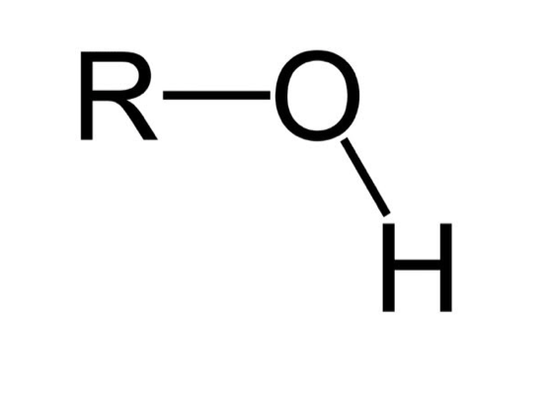
Functional Groups
Identify the functional group!!!!!!
Carboxyl
Hydroxyl
Methyl

Slide 58
Functional Groups
Identify the functional group!!!!!!
Amine
Phosphate
Sulfhydryl

Slide 59
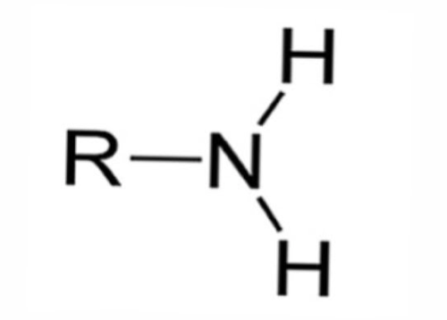
Functional Groups
Identify the functional group!!!!!!
Amine
Phosphate
Sulfhydryl

Slide 60
Functional Groups
Which Functional Groups are in Every Amino Acid?

Slide 61
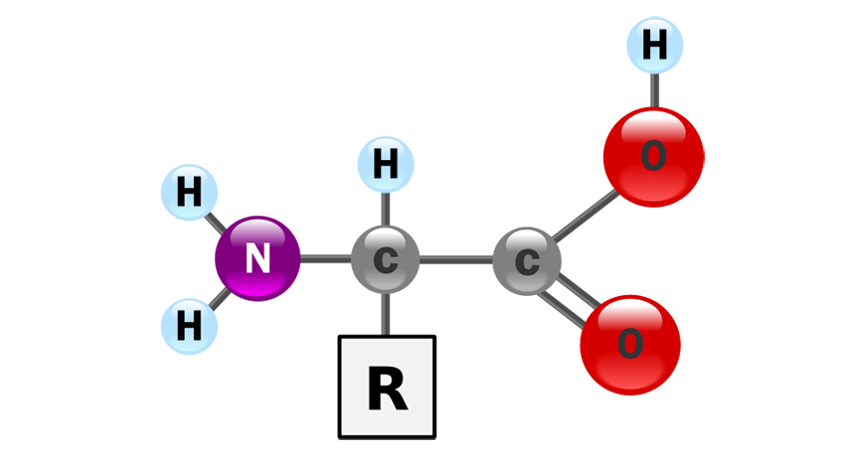
Functional Groups
Which Functional Groups are in Every Amino Acid?
Amine and Carboxyl

Slide 62
Functional Groups
Which Functional Group is used to Deactivate DNA?

Slide 63
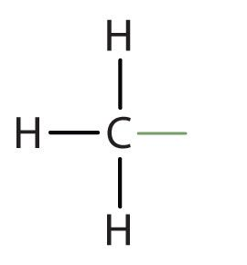
Functional Groups
Which Functional Group is used to Deactivate DNA?
Methyl

Slide 64
Proteins
What is the Monomer of Proteins?

Slide 65
Proteins
What is the Monomer of Proteins?
Amino Acids

Slide 66
Proteins
Where are proteins synthesized?

Slide 67
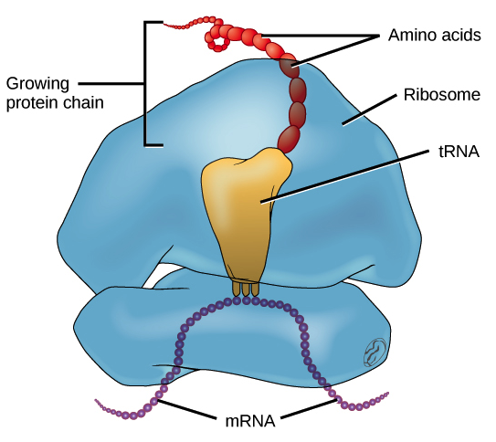
Proteins
Where are proteins synthesized?
Ribosomes

Slide 68
Proteins
What level of protein structure are peptide bonds?

Slide 69
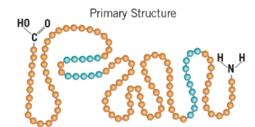
Proteins
What level of protein structure are peptide bonds?
Primary

Slide 70
Proteins
What level of protein structure can show any type of bond?

Slide 71
Proteins
What level of protein structure can show any type of bond?
Tertiary

Slide 72
Proteins
Which level of protein structure R hydrogen bonds?

Slide 73
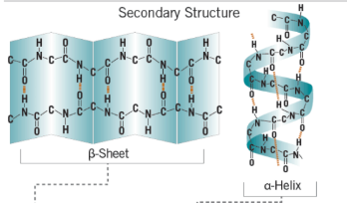
Proteins
Which level of protein structure R hydrogen bonds?
Secondary

Slide 74
Nucleic Acids
What nitrogenous base does RNA have instead of thymine?

Slide 75
Nucleic Acids
What nitrogenous base does RNA have instead of thymine?
Uracil

Slide 76
Nucleic Acids
What type of bone is between each nucleotide?

Slide 77
Nucleic Acids
What type of bone is between each nucleotide?
Phosphodiester

Slide 78
Nucleic Acids
What is the monomer of nucleotides?

Slide 79
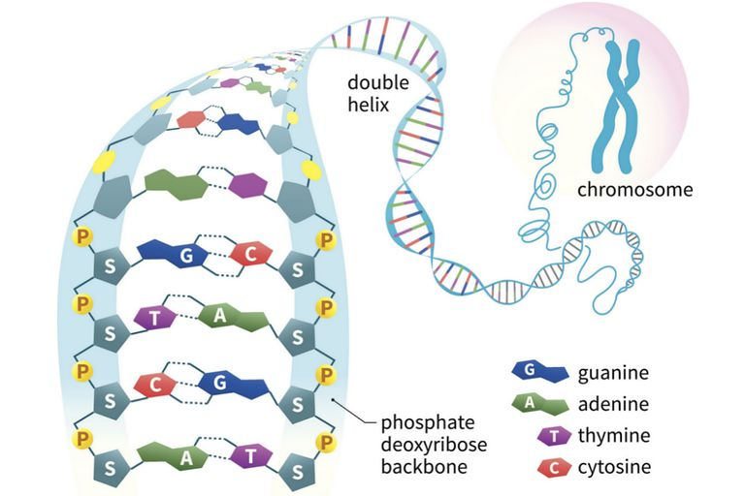
Nucleic Acids
What is the monomer of a nucleic acid?
A nucleotide

Slide 80
Nucleic Acids
What are the three components of a nucleotide?

Slide 81
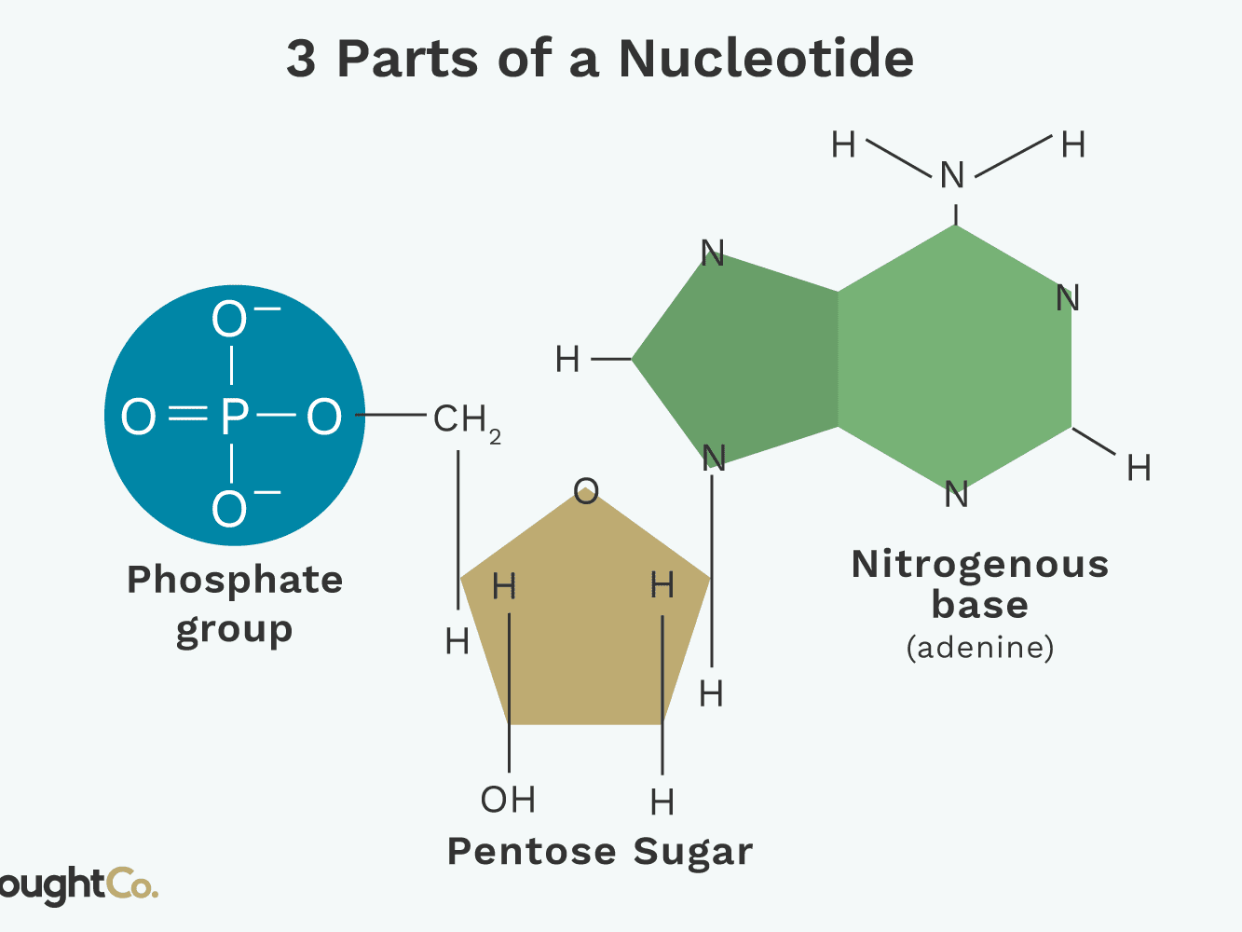
Nucleic Acids
What are the three components of a nucleotide?
A Nitrogenous Base
A Phosphate Group
A Pentose(5-C) Sugar

