Slide 1
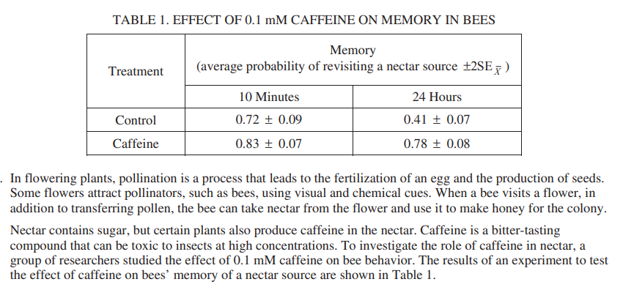
FRQ Friday #1
2017 #1

Slide 2
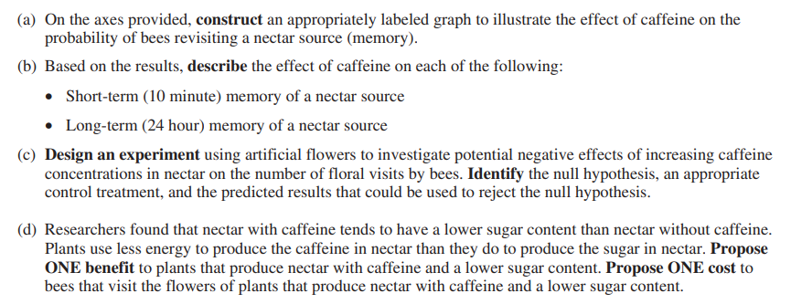
FRQ Friday #1
2017 #1

Slide 3
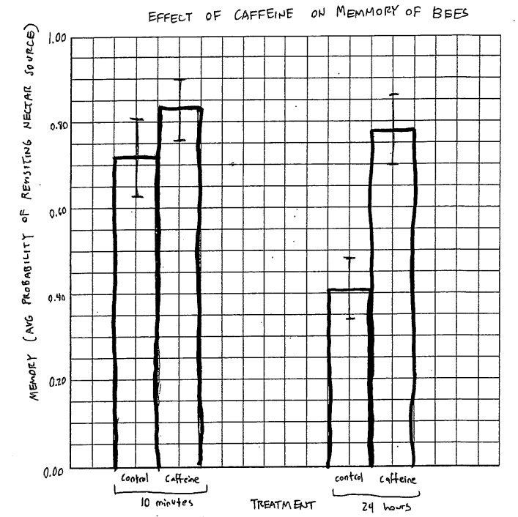
Correctly plotted means on a bar graph or modified bar graph
FRQ Friday #1
2017 #1
Correctly plotted error bars
Appropriate labels, units, and scaling

Slide 4
FRQ Friday #1
2017 #1

Slide 5
FRQ Friday #1
2017 #1

Slide 6
FRQ Friday #1
2017 #1

Slide 7
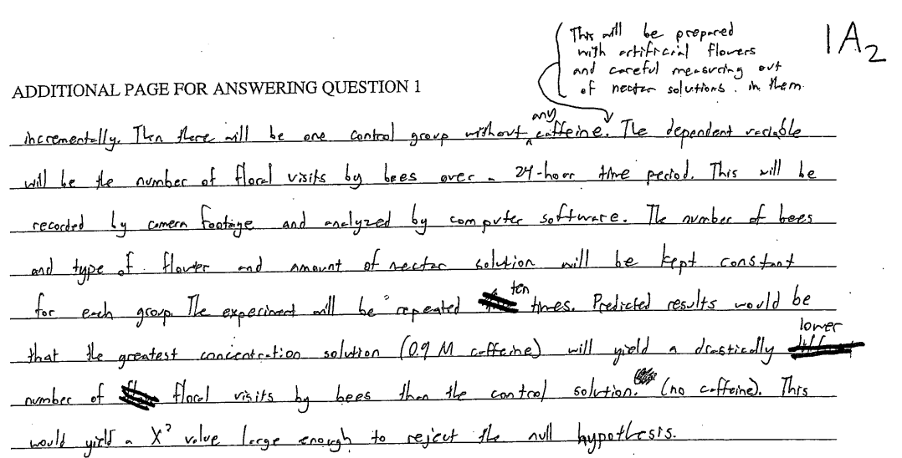
FRQ Friday #1
2017 #1

Slide 8
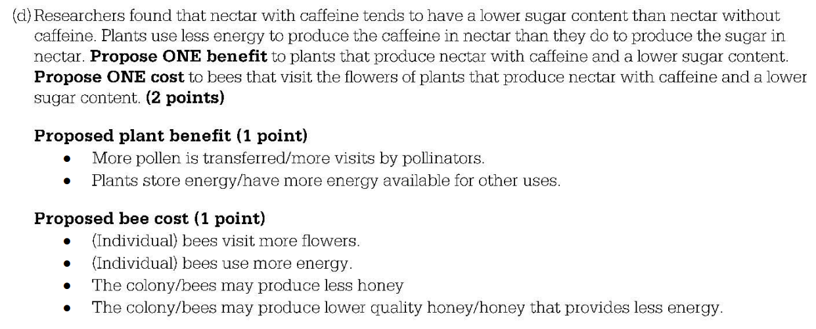
FRQ Friday #1
2017 #1

Slide 9
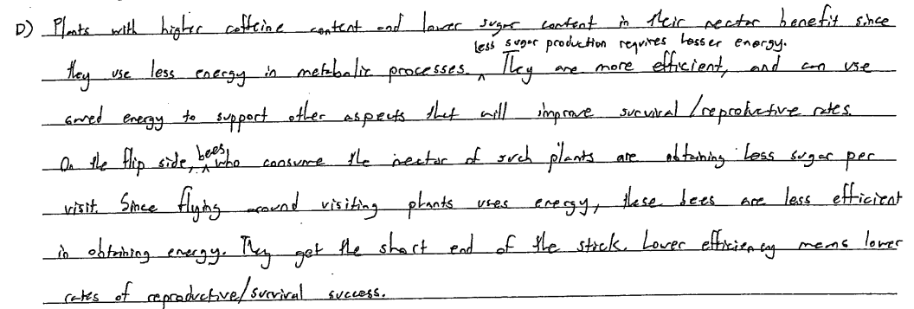
Grading FRQs
2017 #1

