Slide 1
FRQ Friday – 5/7
2017 #1
2016 #8
2015 #5
2014 #4

Slide 2
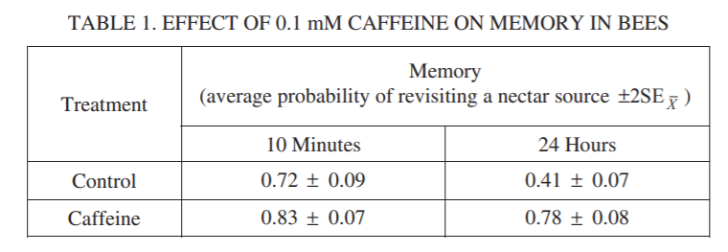
FRQ 2017 #1

Slide 3
FRQ 2017 #1
1..0
Control
Caffeine
0.9
0.8
0.7
0.6
0.5
Memory (Average Probability of Revisiting a Nectar Source)
0.4
10 minutes
24 hours

Slide 4
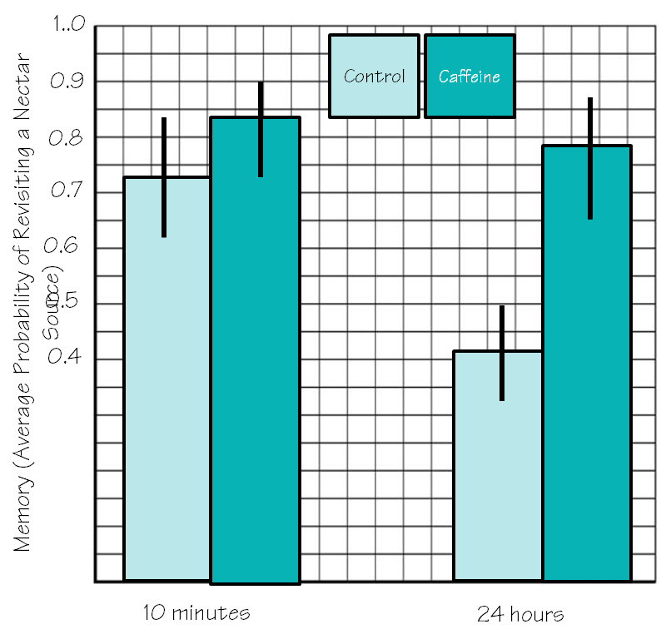
FRQ 2017 #1

Slide 5
FRQ 2017 #1

Slide 6
FRQ 2017 #1

Slide 7
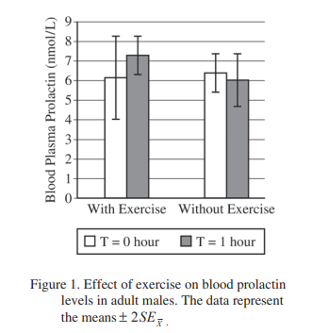
FRQ 2016 #8

Slide 8
FRQ 2016 #8

Slide 9
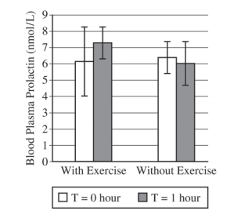
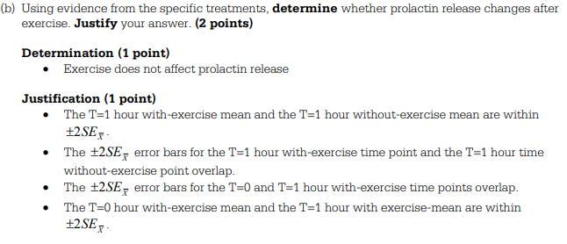
FRQ 2016 #8

Slide 10
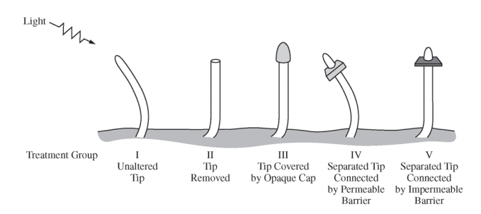
FRQ 2015 #5

Slide 11
FRQ 2015 #5

Slide 12
FRQ 2015 #5

Slide 13
FRQ 2014 #4

Slide 14
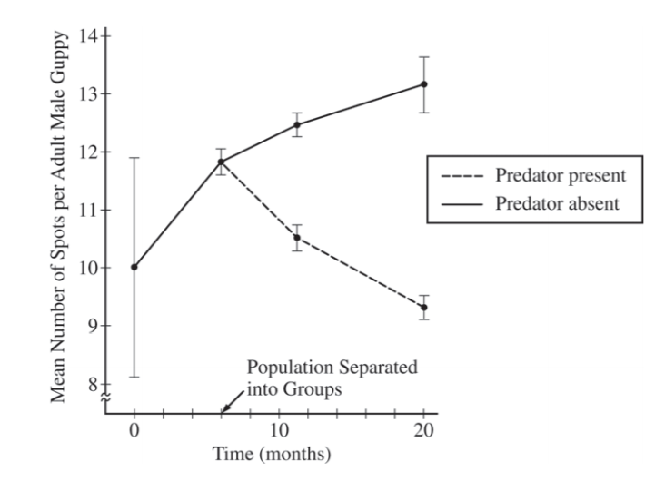
FRQ 2014 #4

Slide 15
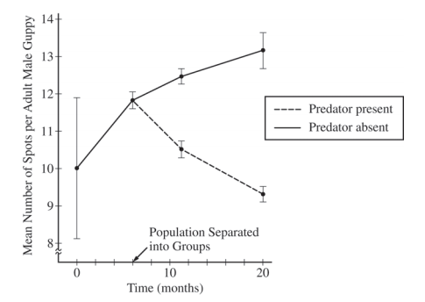
FRQ 2014 #4

Slide 16
FRQ 2014 #4

Slide 17
FRQ 2014 #4

Slide 18
Next FRQ Friday (5/14)
Confidential Information
Your AP Exam FRQs cannot be discussed until they are posted on AP Central … no memes, no reposting, no sharing, no discussing, NOTHING!

Slide 19
Download your 2021 AP Exam app
cb.org/ap2021examapp

